Slide 1
3D Game Basic
26th class
Optimization
Handityo aulia putra

Slide 2
Mini-Project Overview
Pause the game
Implementing Slow Motion
Reducing the number of objects by destroying objects at death a time
Reducing the number of enabled objects by disabling objects whenever possible
Reducing the number of active objects by making objects inactive whenever possible

Slide 3
Games Components Introduction
Components that construct a game:
Audio assets
2D and 3D graphical assets
Text and other file assets
Scripts

Slide 4
Processing in Games
When a game is running, there are many competing processing requirements for CPU and GPU, including:
Audio processing
Script processing
2D physics processing
3D physics processing
Graphical rendering
GPU processing

Slide 5
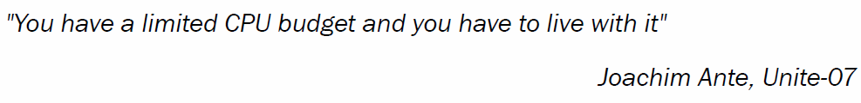
CPU Processing is Limited

Slide 6
Reducing Game Processing
Several methods to reduce the complexity of graphical computations and to improve frame rates are:
To use simpler models whenever possible
Level of Details (LOD) – for far object
reducing the triangle/vertex geometry

Slide 7
MiniProject-1: Pausing the Game
Extra-1

Slide 8
Pausing the Game
1. Import the BallGame package into your project
from the Project view, open the level named BallGame_01.
2. In the Inspector, create a new tag Ball,
apply this tag to prefab ball in Prefabs folder, and
save the scene.

Slide 9
Pausing the Game
3. From the Hierarchy view,
use the Create drop-down menu to add a Panel to the UI (Create | UI | Panel).
Note that it will automatically add it to the current Canvas in the scene.
Rename the panel QualityPanel.
4. Now use the Create drop-down menu to add a Slider to the UI (Create | UI | Slider).
Rename it QualitySlider.

Slide 10
Pausing the Game
5. Finally,
use the Create drop-down menu to add a Text to the UI (Create | UI | Text).
Rename it QualityLabel.
Also, from the Inspector view, Rect Transform, change its Pos Y to -25.

Slide 11
Pausing the Game
6. Add the following C# script PauseGame to First Person Controller:
using UnityEngine;
using UnityEngine.UI;
using System.Collections;
public class PauseGame : MonoBehaviour {
public GameObject qPanel;
public GameObject qSlider;
public GameObject qLabel;
public bool expensiveQualitySettings = true;
private bool isPaused = false;
void Start () {
Cursor.visible = isPaused;
Slider slider = qSlider.GetComponent<Slider> ();
slider.maxValue = QualitySettings.names.Length;
slider.value = QualitySettings.GetQualityLevel ();
qPanel.SetActive(false);
}
void Update () {
if (Input.GetKeyDown(KeyCode.Escape)) {
isPaused = !isPaused;
SetPause ();
}
}
private void SetPause(){
float timeScale = !isPaused ? 1f : 0f;
Time.timeScale = timeScale;
Cursor.visible = isPaused;
GetComponent<MouseLook> ().enabled = !isPaused;
qPanel.SetActive (isPaused);
}
public void SetQuality(float qs){
int qsi = Mathf.RoundToInt (qs);
QualitySettings.SetQualityLevel (qsi);
Text label = qLabel.GetComponent<Text> ();
label.text = QualitySettings.names [qsi];
}
}

Slide 12
Pausing the Game
7. From the Hierarchy view,
select the First Person Controller.
Then, from the Inspector,
access the Pause Game component and
populate the QPanel, QSlider, and QLabel fields with the game objects QualityPanel, QualitySlider, and QualityLabel respectively,

Slide 13
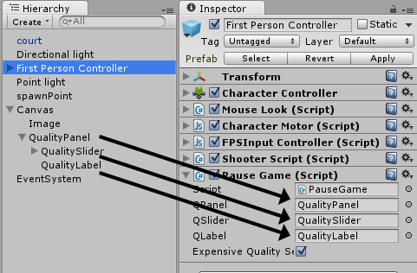
Pausing the Game

Slide 14
Pausing the Game
8. From the Hierarchy view,
select QualitySlider.
Then, from the Inspector view,
Slider component,
find the list named On Value Changed (Single),
click on the + sign to add a command

Slide 15
Pausing the Game
9. Drag the First Person Controller from the Hierarchy view into the game object field of the new command.
Then, use the function selector to find the SetQuality function under Dynamic float (No Function | PauseGame | Dynamic float | SetQuality)

Slide 16
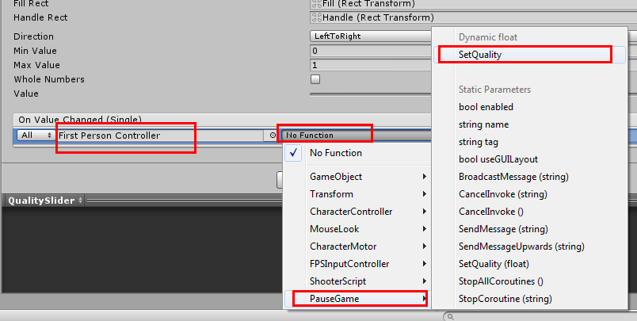
Pausing the Game

Slide 17
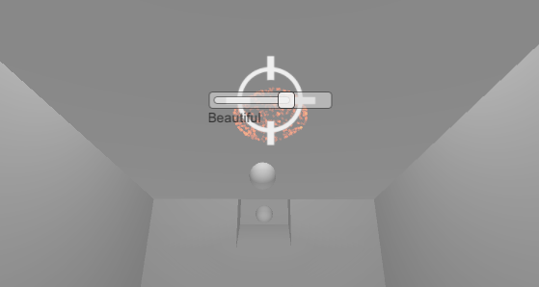
Pausing the Game
10. When you play the scene, you should be able to pause/resume the game by pressing the Esc key

Slide 18
Pausing the Game - How
Pausing the game is actually an easy, straightforward task in Unity:
all we need to do is
set the game's Time Scale to 0
(and set it back to 1 to resume).

Slide 19
Pausing the Game - How
In our code,
we have included such a command within the SetPause() function,
which is called whenever the player presses the Esc key, also toggling the isPaused variable.

Slide 20
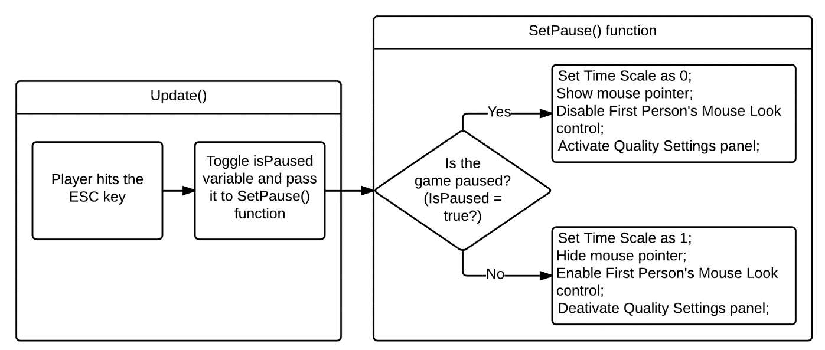
Pausing the Game - How

Slide 21
MiniProject-2: Implementing slow motion
Extra-2

Slide 22
Implementing slow motion
1. Import the BallGame package into your project and,
from the Project view,
open the level named BallGame_01.
2. In the Inspector,
create a new tag Ball,
apply this tag to prefab ball in the Prefabs folder, and
save the scene.

Slide 23
Implementing slow motion
3. Add the following C# script BulletTime to First Person Controller:
if (isSlow) {
elapsed += Time.deltaTime / sloSpeed;
if (elapsed >= totalTime) {
SetSpeed (1f);
}
} else {
elapsed -= Time.deltaTime * recoveryRate;
elapsed = Mathf.Clamp (elapsed, 0, totalTime);
}
float remainingTime =
(totalTime - elapsed) / totalTime;
EnergyBar.value = remainingTime;
}
private void SetSpeed (float speed)
{
Time.timeScale = speed;
Time.fixedDeltaTime = 0.02f * speed;
isSlow = !(speed >= 1.0f);
}
}
using UnityEngine;
using UnityEngine.UI;
using System.Collections;
public class BulletTime : MonoBehaviour
{
public float sloSpeed = 0.1f;
public float totalTime = 10f;
public float recoveryRate = 0.5f;
public Slider EnergyBar;
private float elapsed = 0f;
private bool isSlow = false;
void Update ()
{
if (Input.GetButtonDown ("Fire2")
&& elapsed < totalTime)
SetSpeed (sloSpeed);
if (Input.GetButtonUp ("Fire2"))
SetSpeed (1f);

Slide 24
Implementing slow motion
4. From the Hierarchy view,
use the Create drop-down menu to add a Slider to the UI (Create | UI | Slider).
Please note that it will be created as a child of the preexisting Canvas object.
Rename it EnergySlider.

Slide 25
Implementing slow motion
5. Select EnergySlider and, from the Inspector view, Rect Transform component,
set its position as follows:
Left: 0; Pos Y: 0; Pos Z: 0;
Right: 0; Height: 50.
Then, expand the Anchors settings and change it to:
Min X: 0; Y: 1;
Max X: 0.5; Y: 1;
Pivot X: 0; Y: 1,

Slide 26
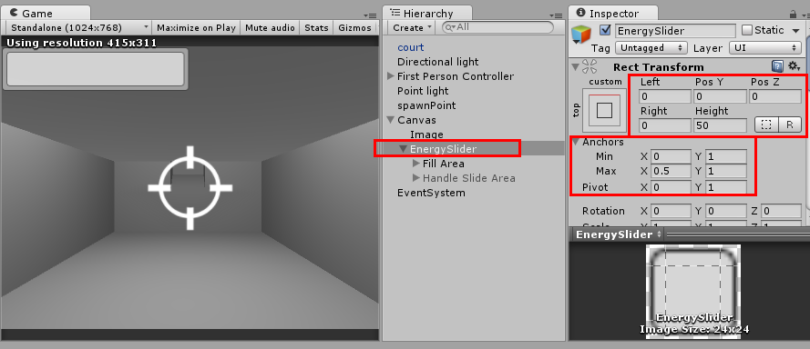
Implementing slow motion

Slide 27
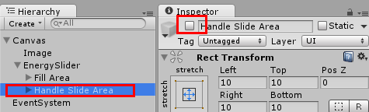
Implementing slow motion
6. Also select the Handle Slide Area child and disable it from the Inspector view,

Slide 28
Implementing slow motion
7. Finally,
select the First Person Controller from the Hierarchy view,
find the Bullet Time component, and
drag the EnergySlider from the Hierarchy view into its Energy Bar slot,

Slide 29
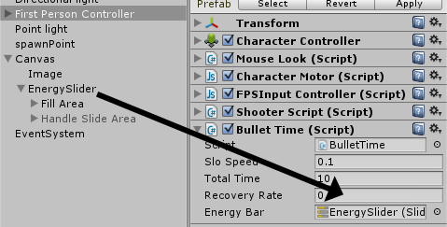
Implementing slow motion

Slide 30
Implementing slow motion
8. Play your game.
You should be able to activate slow motion by holding down the right mouse button
(or whatever alternative you have set for Input axis Fire2).

Slide 31
Implementing slow motion
Basically, all we need to do to have the slow motion effect is decrease the Time.timeScale variable.
In our script, we do that by using the sloSpeed variable.
Please note that we also need to adjust the Time.fixedDeltaTime variable, updating the physics simulation of our game.

Slide 32
OPTIMIZATION

Slide 33
OPTIMIZATION
Optimization principals:
Minimize the number of active and enabled objects in a scene
Minimize actions requiring Unity to perform “reflection” over objects and searching of all current scene objects
Call methods as few times as possible
Use performance data to drive design and coding decisions
Minimize the number of draw calls

Slide 34
Optimization 1
Minimize the number of active and enabled objects in a scene

Slide 35
Minimize the number of active and enabled objects in a scene
Reducing the number of objects by destroying objects at death a time
Reducing the number of enabled objects by disabling objects whenever possible
Reducing the number of active objects by making objects inactive whenever possible

Slide 36
MiniProject-3: 1A. Reducing the number of objects by destroying objects at death a time

Slide 37
1A. Reducing the number of objects by destroying objects at death a time
One way to reduce the number of active objects is to
destroy objects when they are no longer needed.
As soon as an object is no longer needed, we should destroy it;
this saves both memory and processing resources
Unity no longer needs to send the object such messages as Update() and FixedUpdate(), or consider object collisions or physics and so on.

Slide 38
1A. Reducing the number of objects by destroying objects at death a time
However,
there may be times when
we wish not to destroy an object immediately, but at some known point in the future.
Examples might include
after a sound has finished playing, the player only has a certain time to collect a bonus object before it disappears,
an object displaying a message to the player should disappear after a certain time.

Slide 39
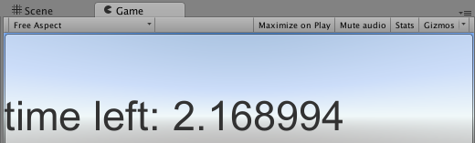
1A. Reducing the number of objects by destroying objects at death a time
This project demonstrates
how objects can be told to start dying, and then to automatically destroy them after a given delay has passed.

Slide 40
1A. Reducing the number of objects by destroying objects at death a time
1. Create a new 2D project.
2. Create a UI Button named Click Me, and make it stretch to fill the entire window.
3. In the Inspector, set the Button's Text child to have left-aligned and large text.

Slide 41
1A. Reducing the number of objects by destroying objects at death a time
4. Add the following script class DeathTimeExample.cs to Button Click Me:
using UnityEngine;
using System.Collections;
using UnityEngine.UI;
public class DeathTimeExample : MonoBehaviour {
public void BUTTON_ACTION_StartDying() {
deathTime = Time.time + deathDelay;
}
public float deathDelay = 4f;
private float deathTime = -1;
public Text buttonText;
void Update(){
if(deathTime > 0){
UpdateTimeDisplay();
CheckDeath();
}
}
private void UpdateTimeDisplay(){
float timeLeft = deathTime - Time.time;
string timeMessage = "time left: " + timeLeft;
buttonText.text = timeMessage;
}
private void CheckDeath(){
if(Time.time > deathTime) Destroy( gameObject );
}
}

Slide 42
1A. Reducing the number of objects by destroying objects at death a time
5. Drag the Text child of Button Click Me into the script's public variable Button Text
6. With Button Click Me selected in the Hierarchy,
add a new On Click() event for this button,
dragging the button itself as the target GameObject and
selecting public function BUTTON_ACTION_StartDying()

Slide 43
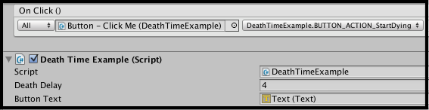
1A. Reducing the number of objects by destroying objects at death a time

Slide 44
1A. Reducing the number of objects by destroying objects at death a time
7. Now, run the scene;
once the button is clicked, the button's text should show the countdown.
Once the countdown gets to zero,
Button Click Me will be destroyed
(including all its children, in this case, just the GameObject Text).

Slide 45
MiniProject-4: 1B. Reducing the number of enabled objects by disabling objects whenever possible

Slide 46
1B. Reducing the number of enabled objects by disabling objects whenever possible
Sometimes, we may not want to completely remove an object, but we can identify times when a scripted component of an object can be safely disabled.
If a MonoBehaviour script is disabled,
then Unity no longer needs to send the object messages, such as Update()and FixedUpdate(), for each frame.

Slide 47
1B. Reducing the number of enabled objects by disabling objects whenever possible
For example,
if a Non-Player Character (NPC) should only demonstrate some behavior when the player can see that character,
then we only need to be executing the behavior logic when the NPC is visible—
the rest of the time, we can safely disable the scripted component.

Slide 48
1B. Reducing the number of enabled objects by disabling objects whenever possible
Unity provides the very useful events
OnBecameInvisible() and
OnBecameVisible(),
which inform an object when it moves out of and into the visible area for one or more cameras in the scene.

Slide 49
1B. Reducing the number of enabled objects by disabling objects whenever possible
This recipe illustrates the following rule of thumb:
if an object has no reason to be doing actions when it cannot be seen, then we should disable that object while it cannot be seen.

Slide 50
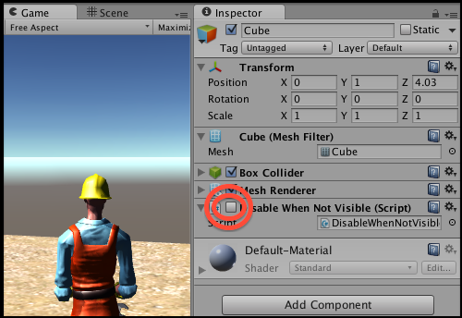
1B. Reducing the number of enabled objects by disabling objects whenever possible

Slide 51
1B. Reducing the number of enabled objects by disabling objects whenever possible
1. Create a new Unity project,
importing the provided Unity package unity4_assets_handyman_goodDirt.
2. Create a new Terrain
(size 20 x 20, located at -10, 0, -10) and
texture-paint it with GoodDirt
(which you'll find in the Standard Assets folder from your import of the Terrain Assets package).
Or any texture is OK

Slide 52
1B. Reducing the number of enabled objects by disabling objects whenever possible
3. Add a 3rdPersonController at (0, 1, 0).
4. Create a new Cube just in front of your 3rdPersonController
(so it is visible in the Game panel when you start running the game).

Slide 53
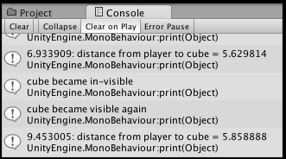
1B. Reducing the number of enabled objects by disabling objects whenever possible
using UnityEngine;
using System.Collections;
public class DisableWhenNotVisible : MonoBehaviour {
private GameObject player;
void Start(){
player = GameObject.FindGameObjectWithTag("Player");
}
void OnBecameVisible() {
enabled = true;
print ("cube became visible again");
}
void OnBecameInvisible() {
enabled = false;
print ("cube became invisible");
}
void Update(){
//do something, so we know when this script is NOT
doing something!
float d =
Vector3.Distance( transform.position,
player.transform.position);
print(Time.time + ":
distance from player to cube = " + d);
}
}
5. Add the following C# script class DisableWhenNotVisible to your Cube:

Slide 54
1B. Reducing the number of enabled objects by disabling objects whenever possible - additional
Note – viewable in Scene panel still counts as visible!
Note that even if the Game panel is not showing (rendering) an object,
if the object is visible in a Scene panel, then it will still be considered visible.
Therefore, it is recommended that you hide/close the Scene panel when testing this recipe, otherwise it may be that the object does only becomes non-visible when the game stops running.

Slide 55
1B. Reducing the number of enabled objects by disabling objects whenever possible - additional
Another common case – only enable after OnTrigger()
Another common situation is that
we only want a scripted component to be active if the player's character is nearby
(within some minimum distance).

Slide 56
1B. Reducing the number of enabled objects by disabling objects whenever possible - additional
Another common case – only enable after OnTrigger()
In these situations,
a sphere collider (with Is Trigger checked) can be set up on the object to be disabled/enabled and
the scripted component can be enabled only when the player's character enters that sphere.

Slide 57
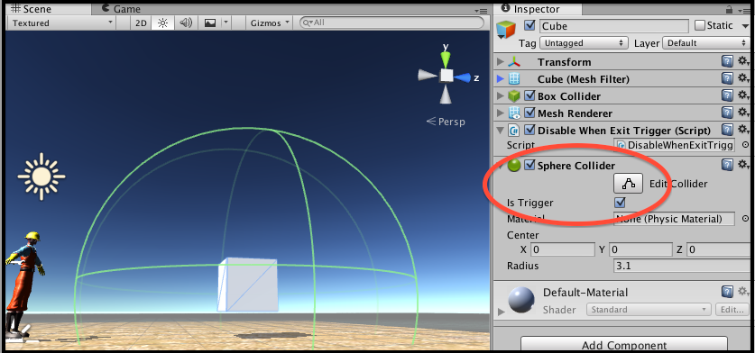
1B. Reducing the number of enabled objects by disabling objects whenever possible - additional
The following screenshot illustrates a large sphere collider having been created around the cube, with its Trigger enabled:

Slide 58
1B. Reducing the number of enabled objects by disabling objects whenever possible - additional
Many computer games (such as Half Life)
use environmental design such as corridors to optimize memory usage by loading and unloading different parts of the environment.
For example,
when a player hits a corridor trigger, environment objects load and unload.

Slide 59
MiniProject-5: 1C. Reducing the number of active objects by making objects inactive whenever possible

Slide 60

1C. Reducing the number of active objects by making objects inactive whenever possible
Sometimes,
we may not want to completely remove an object, but it is possible to go one step further than disabling a scripted component by making the parent GameObject that contains the scripted component inactive.
This is just like deselecting the checkbox next to the GameObject in the Inspector, as shown in the following screenshot:

Slide 61
1C. Reducing the number of active objects by making objects inactive whenever possible
1. Copy the previous recipe.
2. Remove the scripted component DisableWhenNotVisible from your Cube, and instead, add the following C# script class InactiveWhenNotVisible to Cube:
public GameObject makeActiveAgainButton;
private GameObject player;
void Start(){
player = GameObject.FindGameObjectWithTag("Player");
}
void OnBecameInvisible() {
makeActiveAgainButton.SetActive(true);
print ("cube became invisible");
gameObject.SetActive(false);
}
void Update(){
float d = Vector3.Distance( transform.position, player.
transform.position);
print(Time.time + ": distance from player to cube =
" + d);
}
}
using UnityEngine;
using System.Collections;
using UnityEngine.UI;
public class InactiveWhenNotVisible : MonoBehaviour {
// button action
public void BUTTON_ACTION_MakeActive(){
gameObject.SetActive(true);
makeActiveAgainButton.SetActive(false);
}

Slide 62
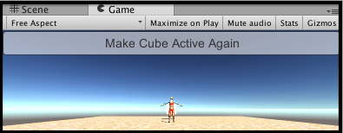
1C. Reducing the number of active objects by making objects inactive whenever possible
3. Create a new Button,
containing the text Make Cube Active Again, and
position the button so that it is at the top of the Game panel and stretches the entire width of the Game panel,
as shown in the following screenshot:

Slide 63
1C. Reducing the number of active objects by making objects inactive whenever possible
4. With the Button selected in the Hierarchy,
add a new On Click() event for this button,
dragging the Cube as the target GameObject and
selecting public function BUTTON_ACTION_makeCubeActiveAgain().

Slide 64
1C. Reducing the number of active objects by making objects inactive whenever possible
5. Uncheck the active checkbox next to the Button name in the Inspector
(in other words, manually deactivate this Button so that we don't see the Button when the scene first runs).

Slide 65
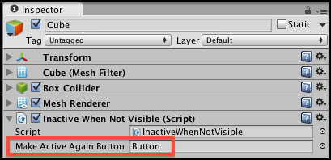
1C. Reducing the number of active objects by making objects inactive whenever possible
6. Select the Cube in the Inspector
drag the Button into the MakeActiveAgainButton variable slot of its script class InactiveWhenNotVisible component,
as shown in the following screenshot:

